Slide 1
Chapter-2

Slide 2
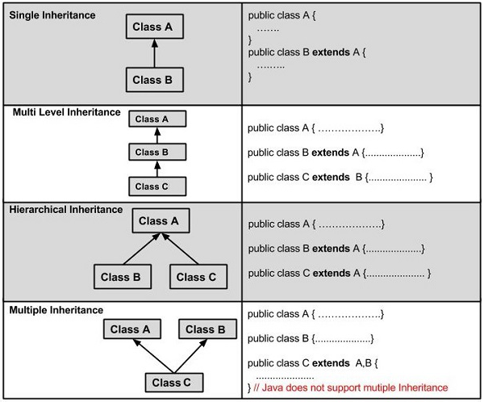
Inheritance

Slide 3
Acquiring properties
That is accessing properties and methods.
Word used for inheritance is=“extends”
Parent class
Super class
Base class
Child class
Sub class
Derived class

Slide 4
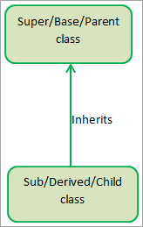
Single inheritance

Slide 5
Super keyword
The super keyword in Java is used in subclasses to access
superclass members (attributes, constructors and methods).
Uses of super keyword
To call methods of the superclass that is overridden in the subclass.
To access attributes (fields) of the superclass if both superclass and subclass have attributes with the same name.
To explicitly call superclass no-arg (default) or parameterized constructor from the subclass constructor.

Slide 6
Abstraction
Abstraction is details hiding(implementation hiding).
Showing only essential part.
Abstraction is showing interface and hiding details of implementation from user.
We can achieve abstraction in java by 2 ways:-
1)Abstract class(0-100%)
2)Interface(purely achieved by use-100%)

Slide 7
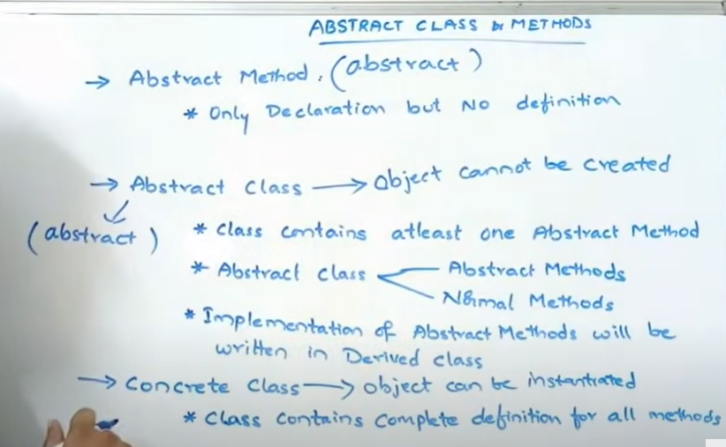
Abstract class and abstract method
Use abstract keyword

Slide 8
If any method within class is abstract then it must be renamed as abstract class..
But if we declare any class as abstract then it is not necessary that any of the method should abstract. It may also include only concrete methods also.

Slide 9
What is Polymorphism in Java?
Polymorphism is considered one of the important features of Object-Oriented Programming. Polymorphism allows us to perform a single action in different ways.
In other words, polymorphism allows you to define one interface and have multiple implementations.
The word “poly” means many and “morphs” means forms, So it means many forms.

Slide 10
Real life example:-
A person at the same time can have different characteristics. Like a man at the same time is a father, a husband, and an employee. So the same person possesses different behaviors in different situations. This is called polymorphism.

Slide 11
Polymorphism-compile time polymorphism
Polymorphism can be achieved with the help of:-
Constructor overloading
Operator overloading
Method overloading

Slide 12
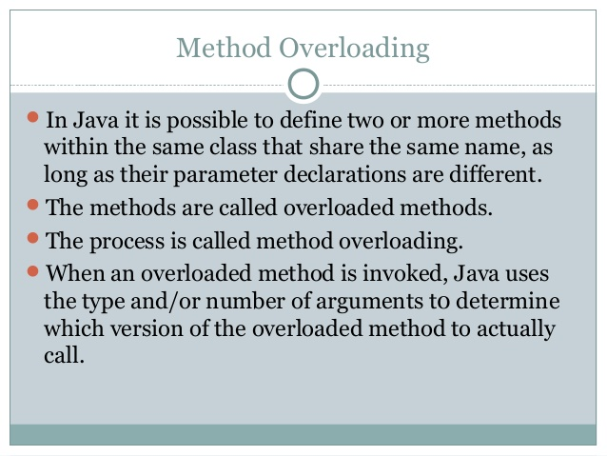

Slide 13
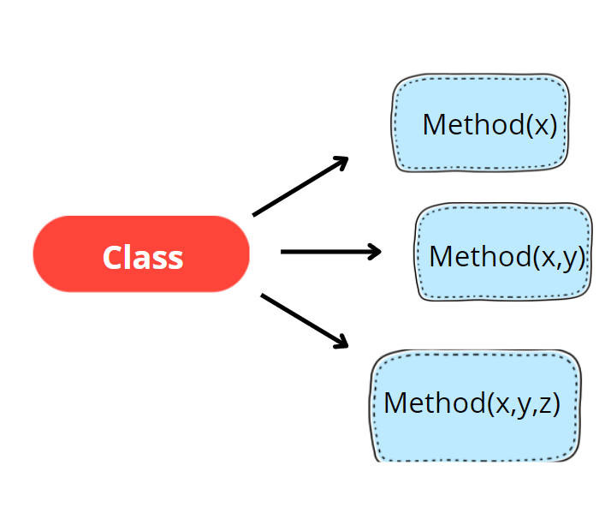
Method overloading

Slide 14
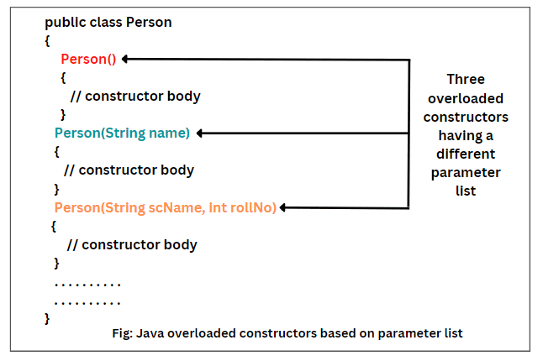
Constructor overloading

Slide 15
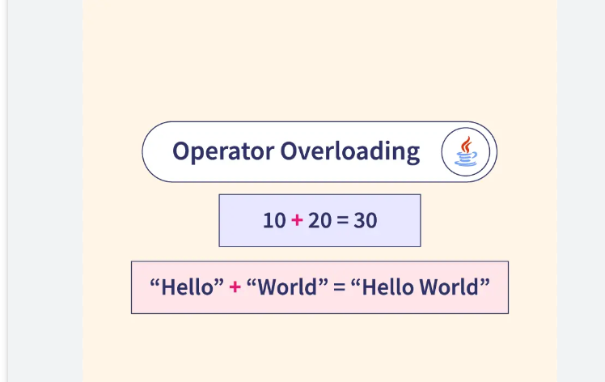
Operator overloading

Slide 16
Method overriding-run time polymorphism
Super class and sub class having same name for methods.
Class A
Display()
Class B
Display()

Slide 17
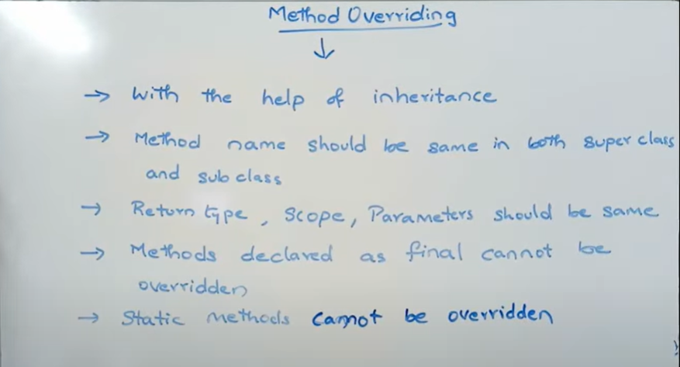
Method overriding

Slide 18
@Override annotation specifies the compiler that the method after this annotation overrides the method of the superclass.
It is not mandatory to use @Override .
Runtime polymorphism, also known as the Dynamic Method Dispatch, is a process that resolves a call to an overridden method at runtime. The process involves the use of the reference variable of a superclass to call for an overridden method.

Slide 19
Final keyword
We can use final keyword-with variables, methods and class.
If we create any variable as final, it becomes constant, we can not change value of final variable.
If we create any method as final, we can not override it.
If we create any class as final, we can not extend it or inherit it.

Slide 20
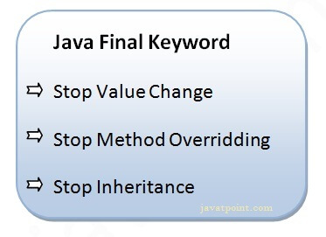

Slide 21
this keyword in java
This represents instance variables of current object.

Slide 22
Interfaces
Used to achieve multiple inheritance.
Interface is not a class.
Use keywords-interface, implements
In the interfaces we can only have a abstract method.
All the methods are by default abstract public.
We can not create object of interfaces.
all the variables in interface are final and static

Slide 23
Need for an interfaces
an interface can be defined as a container that stores the signatures of the methods to be implemented in the code segment.
It improves the levels of Abstraction,by providing abstract layers.

Slide 24
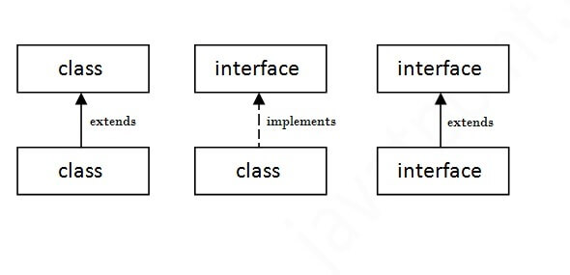
Class-→class====extends
Class→interface===implements
Interface -interface===extends

Slide 25
Default methods in interfaces
Before Java 8, interfaces could have only abstract methods.
So, if a new method is to be added in an interface, then its implementation code has to be provided in the class implementing the same interface.
To overcome this issue, Java 8 has introduced the concept of default methods
which allow the interfaces to have methods with implementation without affecting the classes that implement the interface.
Default methods can be override.

Slide 26
Static methods in interfaces
These are same as default methods,but it’s implementation in child class can not be changed
Means static methods of the interfaces can not be override.
Simillar to static methods these should also called through interaces names.

Slide 27
Why we need?
Provides security.
Good for providing utility methods.

Slide 28
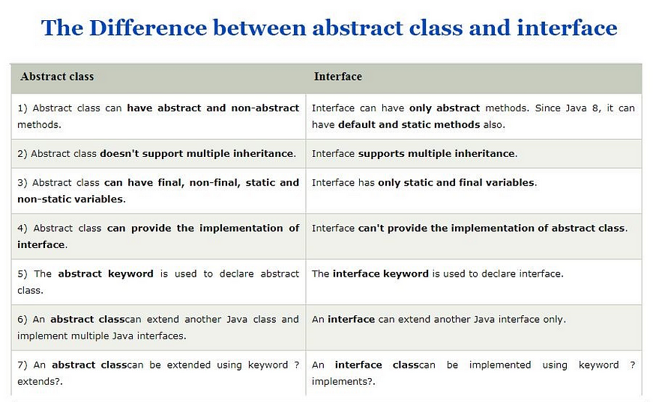

Slide 29
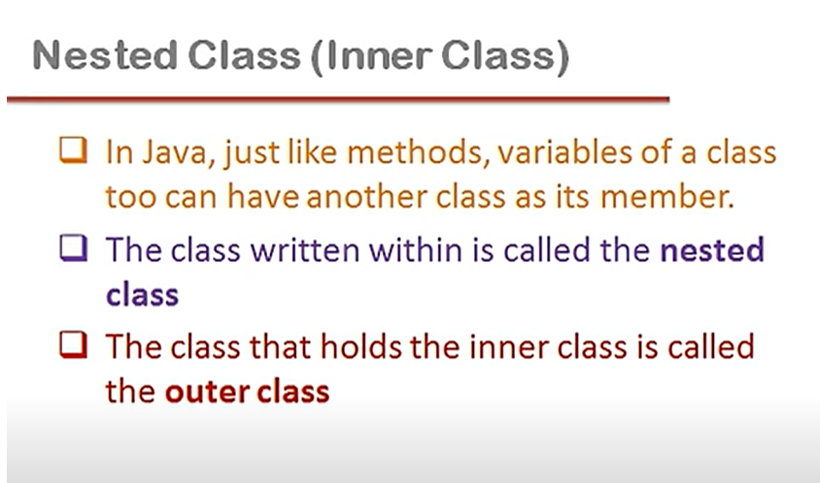
Nested Class

Slide 30
Inner class
Static inner class
Non static inner class

Slide 31
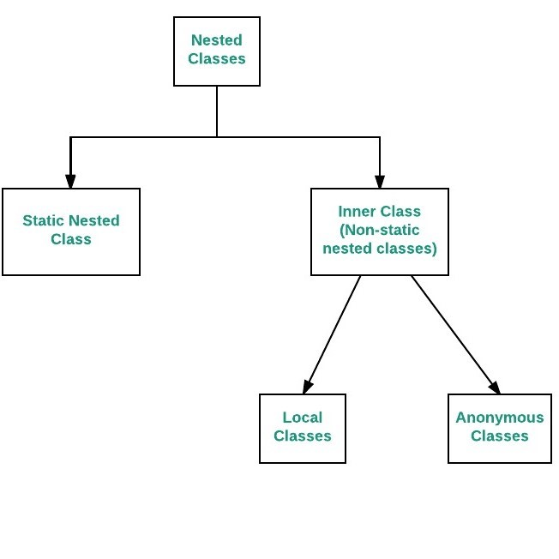

Slide 32
Nested class
static nested class: Nested classes that are declared static are called static nested classes.
inner class: An inner class is a non-static nested class.
2.1-Anonymous class
2.2-Local class

Slide 33
Anonymous class
Java anonymous inner class is an inner class without a name and for which only a single object is created. An anonymous inner class can be useful when making an instance of an object with certain "extras" such as overloading methods of a class or interface, without having to actually subclass a class.
In simple words, a class that has no name is known as an anonymous inner class in Java. It should be used if you have to override a method of class or interface. Java Anonymous inner class can be created in two ways:
Class (may be abstract or concrete).
Interface

Slide 34
Java Local inner class
A class i.e., created inside a method, is called local inner class in java. Local Inner Classes are the inner classes that are defined inside a block.
Generally, this block is a method body. Sometimes this block can be a for loop, or an if clause. Local Inner classes are not a member of any enclosing classes.
They belong to the block they are defined within, due to which local inner classes cannot have any access modifiers associated with them. However, they can be marked as final or abstract. These classes have access to the fields of the class enclosing it.
If you want to invoke the methods of the local inner class, you must instantiate this class inside the method.

Slide 35
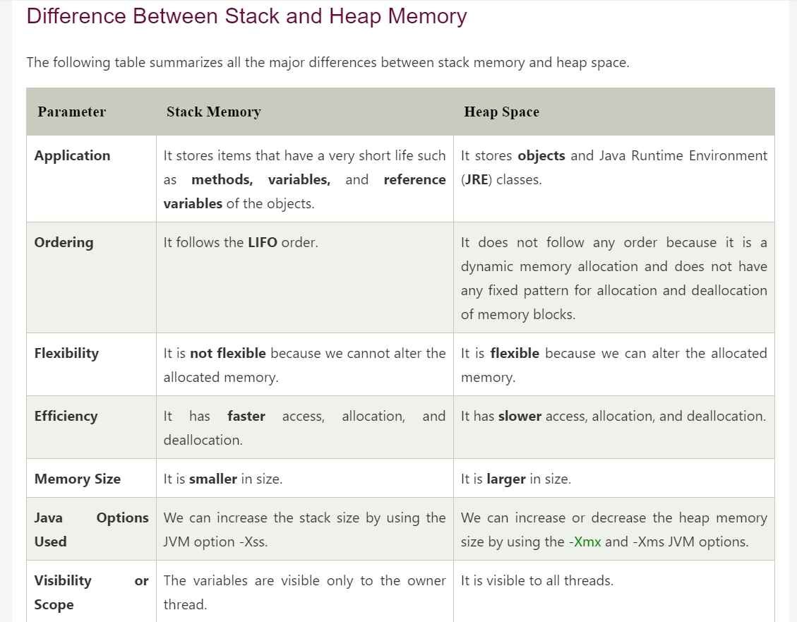

Slide 36
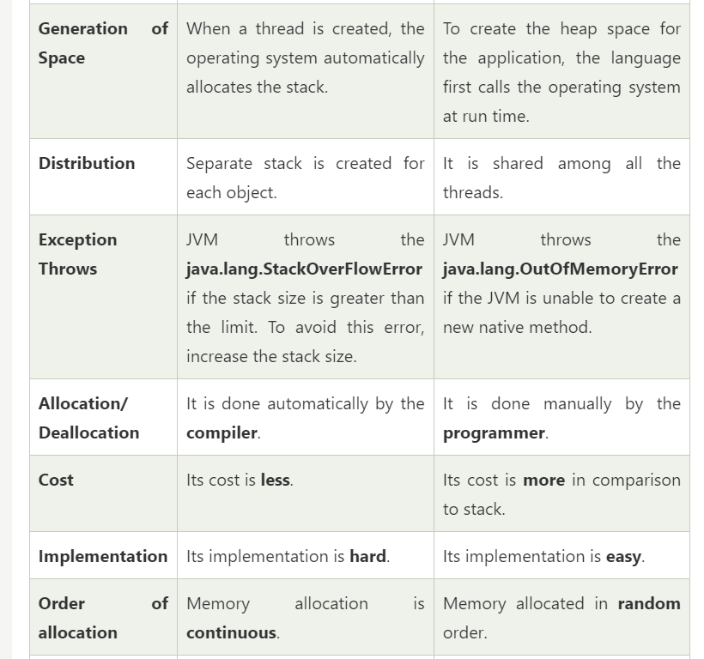

Slide 37
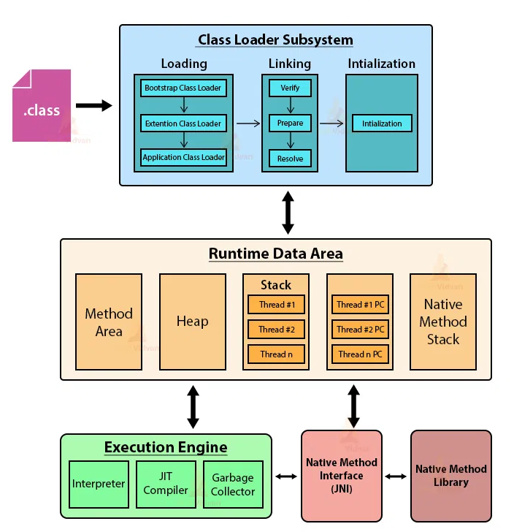

Slide 38
